Slide 1




COMPANY PROFILE
RMC2
CONSULTANCY CORP
Your trusted partner in Health, Life and Non-Life Coverage
www.rmc2consultancycorp.com

Slide 2


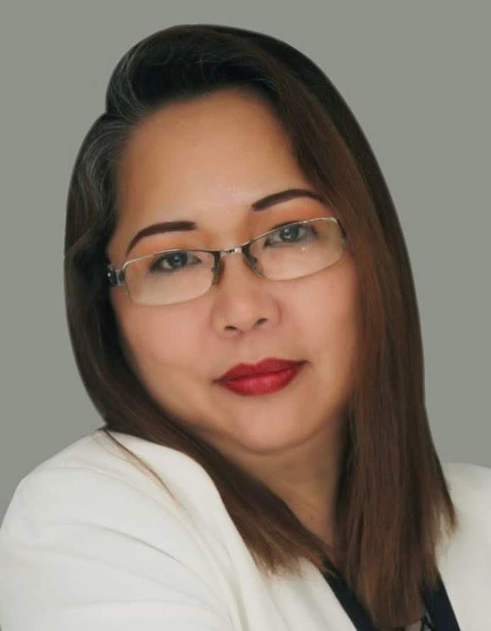
WHO WE ARE
At RMC2 Consultancy Corp, we believe that health and financial security should be accessible to everyone. Founded by Rosemarie Fernandez, who has been in the insurance industry for over 23 years, RMC2 was established with a passion for making a difference. Rosemarie has been exposed to the various needs of the market and decided to create a bridge for Filipinos who are overwhelmed by the process of insurance, making it more accessible and understandable.
We specialize in providing affordable, convenient, and reliable HMO, Life, and Non-Life Insurance solutions tailored to meet diverse needs.
Our mission is simple: to bridge the gap between people and quality healthcare by offering plans that prioritize accessibility and peace of mind. We understand that navigating insurance options can be overwhelming — that's why we take pride in guiding our clients every step of the way, ensuring clarity, compassion, and personalized service.
With a commitment to building lasting relationships, RMC2 Consultancy Corp stands as a trusted partner in safeguarding the well-being and future of individuals, families, and businesses alike.
Let us help you protect what matters most.

Slide 3

ABOUT US
At RMC2, we are dedicated to redefining the insurance experience. We specialize in providing HMO, Life, and Non-Life Insurance solutions that put people first, ensuring that protection isn’t just a privilege but a right for all. Our approach is built on three core principles: Affordability, Accessibility, and Convenience.
We understand that navigating insurance can feel overwhelming, so we’ve made it our mission to simplify the process. From personalized plans to hassle-free assistance, we’re here every step of the way, helping individuals, families, and businesses secure their future with peace of mind.
At the heart of RMC2 is a commitment to building lasting relationships. Whether it’s ensuring quick access to healthcare or offering life protection tailored to your needs, we’re more than just an insurance provider.
We are your trusted partner in safeguarding what matters most which is protecting lives and empowering futures.

Slide 4

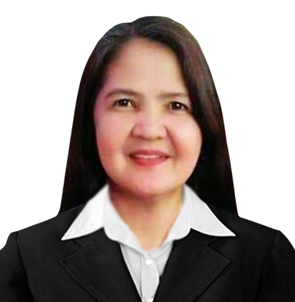


THE MANAGEMENT
ROSEMARIE FERNANDEZ
PRESIDENT & CEO
MICHELLE GUINTO
CHERRY CORTEZ
CLEMENT DOLF FERNANDEZ
CHARLES MARK UYBENGKEE
BOARD OF DIRECTOR
BOARD OF DIRECTOR
BOARD OF DIRECTOR
BOARD OF DIRECTOR

Slide 5

VISION
& MISSION
V > To break barriers where quality health and life protection is within everyone’s reach, ensuring affordability and accessibility for all.
M > To safeguard lives by delivering affordable and accessible HMO, Life, Non-Life Insurance solutions, ensuring everyone has the security and care they deserve.

Slide 6













OUR
PARTNERS
IN HEALTH

Slide 7





OUR
PARTNERS
IN LIFE

Slide 8







OUR
PARTNERS
IN NON-LIFE

Slide 9
















CLIENTS
WE SERVED
AND MORE

Slide 10


OUR GROWING NETWORK
RMC2 CONSULTANCY CORP
A growing consultancy firm for insurance solution with a strong client network, committed to promoting wellness, preventive health, and lifestyle benefits for its members.
1,200
15,300
900
SALES ADVISORS
GROUP ENROLLEES
INDIVIDUAL ACCOUNT
*DATA FROM
SEPTEMBER 2024 - NOVEMBER 2025

Slide 11

OUR
OFFICES
LUZON:
Cainta - HEAD OFFICE
Antipolo
Taytay
Bulacan
Valenzuela
Lipa
Pampanga - OPENING SOON
La Union
Baguio
Isabela
Bicol - OPENING SOON
Quezon City 1 & 2
Ilagan - OPENING SOON
VISAYAS:
Mandaue City - REGIONAL HEAD OFFICE
Cebu City - OPENING SOON
MINDANAO:
General Santos City

Slide 12








RMC2 PRODUCTS
IN PARTNERSHIP WITH AMAPHIL

Slide 13


PARTNERSHIP PERKS

Slide 14



OUR NETWORK PROVIDER
Nationwide hospital and clinic accreditation thru our network provider AMAPHIL
AMAPHIL, or Advanced Medical Access Philippines, Inc., is a technology-powered Third Party Administrator (TPA) that was founded in 2016 to manage self-funded corporate health plans. It connects members to a large network of accredited hospitals, clinics, and physicians, and provides technology-driven services like online consultations via the Doctor Anywhere app. AMAPHIL's goal is to provide cost-effective, high-quality healthcare solutions for companies and their employees
www. amaphil.com.ph

Slide 15
OUR NETWORK PROVIDER
Corporate Officers
Ms. Irene Cara Gatus
Chairman
Ms. Mylene Benitez
Treasurer
Ms. Angeles Ongchangco
Corp Secretary
Ms. Mariane Odi
Board of Director
Atty. Ensign Icamen
Board of Director
www. amaphil.com.ph

Slide 16

Introducing:
FAMILY GUARD
1 Principal
2 Dependents

Slide 17

ELEGIBILITY
 | ENTRY AGE | LAST AGE ACCEPTANCE
Principal | 18 | 64
Dependents
Children | 0 | 23
Parents/Spouse | 18 | 64

Slide 18
HEALTHCARE BENEFITS
In Patient
Out Patient
Emergency Care

Slide 19
INPATIENT BENEFITS
ANNUAL BENEFIT LIMIT (Shared)
150,000
Benefit Limit per confinement
30,000.00
ROOM per day maximum of 31 days
1,500
Notes:
Room and Board: Coverage applies to open room accommodation (ward, semi-private, private, or suite) up to a maximum of Php 1,500 per day for 31 days. Emergency Confinement: If no room within the covered rate is available, expenses during the first 24 hours may be covered. However, if the insured chooses to remain in a higher room category despite room availability, any incremental cost shall be at the insured’s expense. Non-Emergency Confinement: Should the insured occupy a room higher than the covered limit, all excess and incremental charges shall be borne by the insured.

Slide 20
OUT-PATIENT BENEFITS
Face-to-Face Check-ups, Teleconsultations & Laboratory Tests / Examinations to Affiliated AMAPHIL Hospitals/Clinics
Up to the limit
New Laboratory Modalities (including newly introduced diagnostic technologies and procedures) shall be covered up to a maximum of Php 5,000 only.

Slide 21

EMERGENCY CARE
In Affiliated Hospitals: Upto ABL
Physician's services
Emergency Room Fees
Medicines used for immediate relief during treatment
Oxygen, intravenous fluids and blood products
Dressings, conventional casts (plaster of Paris) and sutures
X-ray, laboratory , and diagnostic examinations, and other medical services related to the emergency treatment of the patient.

Slide 22
EMERGENCY CARE
Emergency treatment in non-affiliated
hospitals/clinics- 80% reimbursement based
on AMAPHIL RUV
Emergency treatment in affiliated
hospitals/clinics- 100% reimbursement based
on AMAPHIL RUV
Emergency treatment in areas without affiliated
hospitals/clinics (within a 15 km radius)
100% reimbursement based on AMAPHIL RUV
NOTE: Subject to plan limits

Slide 23
PRE EXISTING CONDITION
Pre-Existing Conditions and Dreaded Diseases are not covered during the first year of enrollment. These conditions may be covered upon renewal, subject to the actuarial evaluation and approval of RMC2, in accordance with the latest computation and underwriting decision.

Slide 24

GENERAL EXCLUSIONS
1. Non-Medically Necessary or Cosmetic Procedures
Plastic or reconstructive surgery for cosmetic purposes (e.g., nose lift, liposuction, facelift). Treatment for obesity, weight reduction, or body contouring. Hair loss treatments, skin whitening, or tattoo removal. Corrective eye surgery for refractive errors (LASIK, etc.).
2. Dental Services Beyond Coverage
Orthodontic braces and retainers. Cosmetic dental procedures (veneers, bleaching). Dentures and prosthetics unless specifically included in the plan.
3. Congenital, Genetic, or Developmental Conditions
Congenital or hereditary diseases (unless included in special plans). Learning disabilities, speech therapy, or developmental therapy. Genetic testing and counseling.
4. Maternity and Reproductive Services
Normal pregnancy, childbirth, and postpartum care (unless maternity coverage is explicitly added). Fertility treatment, artificial insemination, in-vitro fertilization (IVF). Contraceptives, family planning procedures, or voluntary sterilization. Circumcision, except if medically necessary (e.g., infection).

Slide 25
GENERAL EXCLUSIONS
5. Mental Health, Psychiatric, and Psychological Disorders
Psychiatric evaluation, psychotherapy, counseling, and mental health admissions (except if explicitly covered).
Drug or alcohol rehabilitation, detoxification programs.
7. Occupational or Work-Related Injuries
Work-related accidents covered by the Employees Compensation Commission (ECC) or PhilHealth. Injuries from employment hazards or while performing job duties.
8. Self-Inflicted Injuries or Illegal Acts
Suicide or attempted suicide. Self-inflicted harm. Injuries due to participation in criminal acts or resistance to lawful arrest.
9. High-Risk or Hazardous Activities
Injuries from extreme sports or activities (e.g., scuba diving, skydiving, racing, mountaineering, martial arts competitions). Accidents while under the influence of drugs or alcohol.
10. Non-Prescription or Alternative Treatments
Vitamins, supplements, herbal or alternative medicines (e.g., acupuncture, chiropractic care, traditional healers).
Experimental or investigational treatments not approved by DOH or FDA.

Slide 26
GENERAL EXCLUSIONS
11. Non-Covered Diagnostic and Administrative Costs
Executive check-ups are not listed in the APE coverage. Medical certificates, fit-to-work, travel clearance, or police report requirements. Medical supplies not medically necessary (e.g., personal comfort items, toiletries).
12. Organ Transplants and Special Treatments
Organ donor expenses. Dialysis, chemotherapy, radiation, or immunotherapy unless specifically included.
Experimental surgical or medical procedures.
13. Conditions Covered by Government or Other Insurance
Treatments or conditions already covered by PhilHealth, SSS, or ECC benefits.
14. Out-of-Network Services
Consultations or treatments done outside affiliated hospitals/clinics (except for reimbursable emergencies). Overseas medical expenses (unless global coverage is stated).

Slide 27
PREMIUM
29,650
Add 600 for membership fee

Slide 28
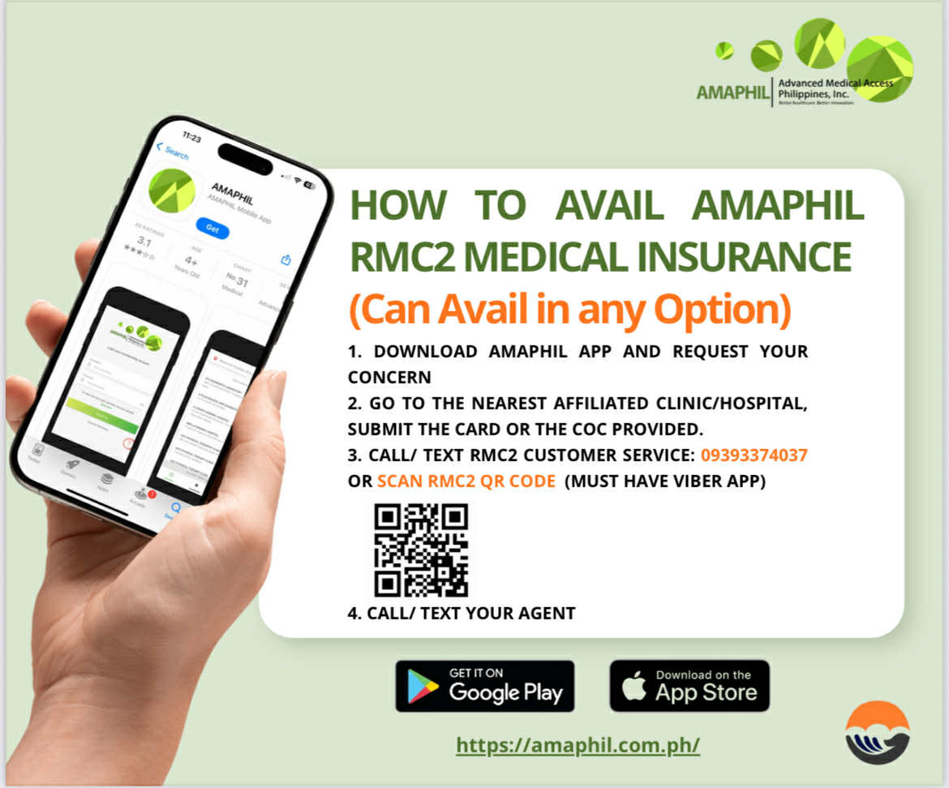

Slide 29
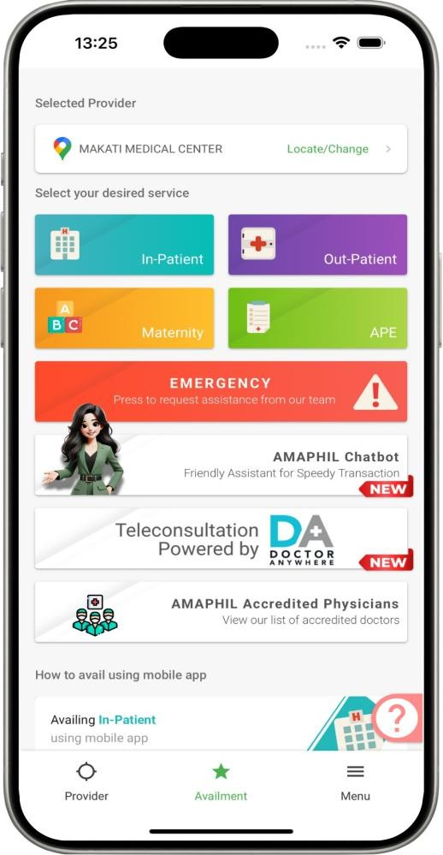
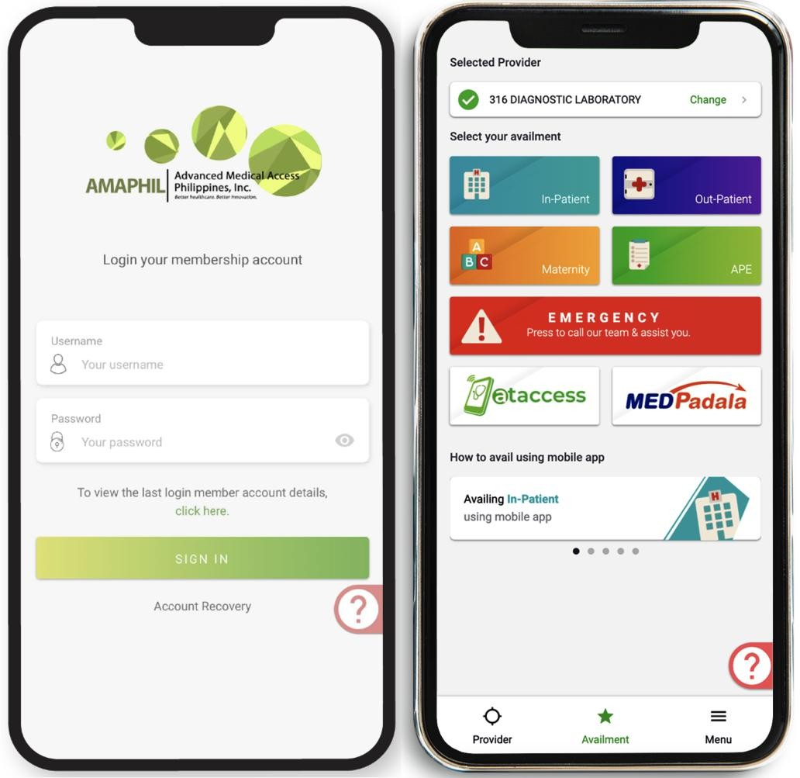
Member’s Mobile Application:
Through AMAPHIL’s mobile application, your employees may access
the following at their fingertips:
Request for LOA prior to availment;
File for reimbursement;
Review the list of benefits, exclusions and availment history;
View the latest list of providers;
See the reason for declined services;
Members can easily press Customer Service button in the Mobile
App and just wait for the AMAPHIL call.

Slide 30
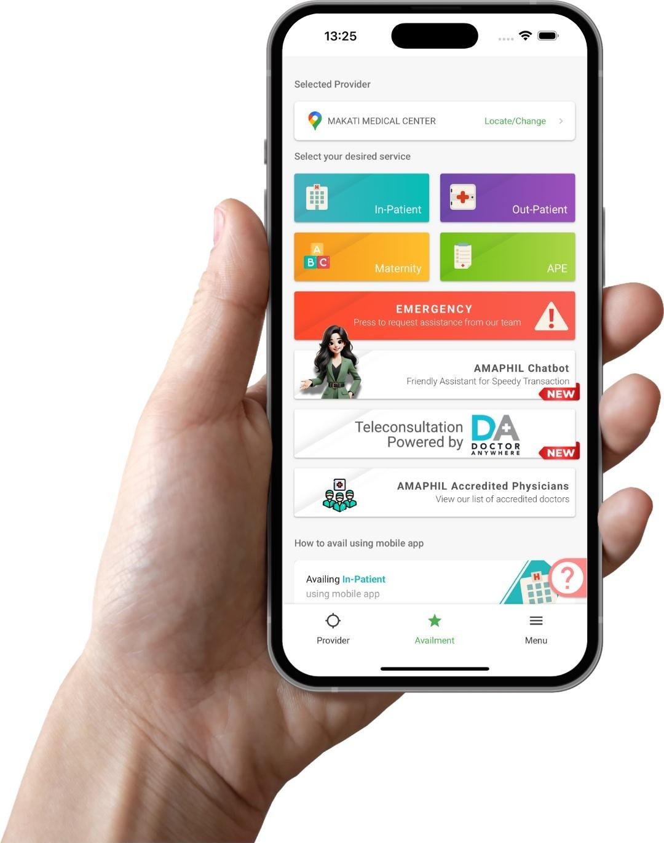
Members have immediate access to over 1,700 hospitals and clinics, and more than 51,000 doctors nationwide. Hence, there is no need to go through a tedious and expensive process of hospital and clinic affiliation.
Reduced patient wait times by using the AMAPHIL Mobile Application.

Slide 31

No Internet or Smartphone?
AMAPHIL Physical Card

Slide 32


Slide 33


THANK YOU!

